Slide 1

DAB-103 ANALYTIC TOOLS AND DECISION MAKING
PROJECT
GROUP-II
PRATIK TEREDESAI (0734870)
PRIYANKA A. BHILARE(0734878)
GURTEJ SINGH UBHI(0734821)
MOHSIN MEGHJANI(0730241)
GURVINDER KAUR(0733915)

Slide 2

About Data- Set
The dataset is “ Trending YouTube Video Statistics” – Daily statistics for trending you tube videos
This dataset is a daily record of the top trending YouTube videos.
This dataset includes several months (and counting) of data on daily trending YouTube videos.
Data is included for the CA, DE,FR,GB,IN,JP,KR,MX,RU,US (Canada, Denmark, France, Great Britain, India, Japan,Korea,Mexico,Russia,USA respectively)with up to 200 listed trending videos per day.

Slide 3
WORK FLOW
The dataset was analyzed and was looked for loop-holes .
Based upon the requirements it was finalized for the better understanding and preparation.
Data Cleaning
Data after analysis is being cleaned . The outliers are being rejected and filtered out for a clear picture of visualisation.
Identification of Business Questions
Based upon the dataset analysis and scenarios , various set of business questions were documented and worked for.
Data Analysis

Slide 4
/
Descriptive Analysis
Extension of ETL(Export Transport Load) with the help of business questions for the better generalisation.
Data Visualisation
This is generation of plots and graphs from the derived various business questions and scenarios covered.

Slide 5

WHY YOUTUBE ?
YouTube is not only the kingdom of digital entertainment but it can also be a great environment for learning.
It is really easy to integrate.
It can be used to create an e-Learning community.
It generates and promotes online discussion.
It is ideal for mobile learning.
It allows for microlearning.
It encourages the development of note-taking skills.
It enhances comprehension of complex concepts.
It allows learners to make their own YouTube videos.

Slide 6

YouTube Usage Statistics
YouTube is the world’s second largest search engine and third most visited site after Google and Facebook
400 hours of video are uploaded to YouTube every minute.
We watch over 1 billion hours of YouTube videos a day, more than Netflix and Facebook video combined.
70% of YouTube views come from mobile devices.
The average mobile viewing session lasts more than 40 minutes

Slide 7
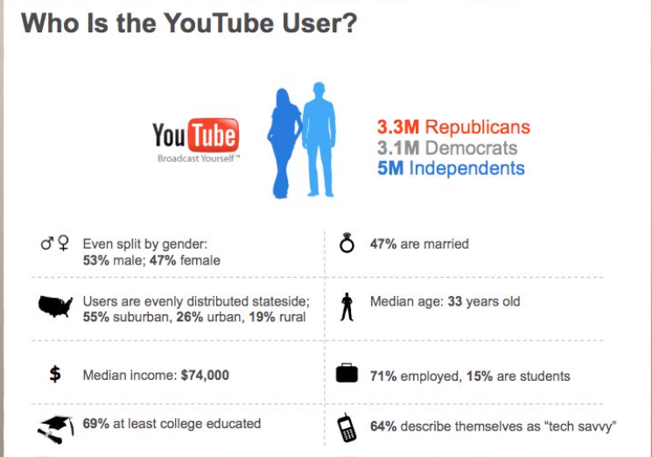
LETS US TALK ABOUT YOUTUBE
4 billion videos are viewed every day800 million unique visitors use YouTube every month Millions of businesses around the world use YouTube to advertise their products and brands

Slide 8
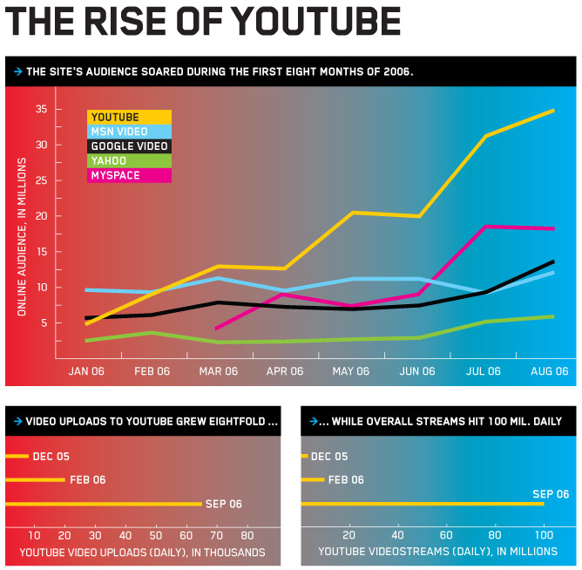

Slide 9

Some Business Questions
Factors that affect how popular a YouTube video would be?
Does likes dislikes really matters , How does it matters as per business perspective?
What should YouTube encourage to new youtuber
Correlation of Likes and Dislikes for Top channels titles and categories
Comparison of YouTube Videos between the Canada and India on the basis of category and other parameters of interest.

Slide 10
DATA CLEANING AND PREPARATION
Does my data seem to make sense?
Are there any duplicates, and if so, is that okay?
Does numerical data add up and make sense?
Are there spelling errors or numbers where there shouldn’t be?

Slide 11

Data cleansing is so important for individuals because eventually, all this information can become overwhelming.
After cleansing, dataset should be consistent with other similar data sets in the system.
In order to provide access to accurate and consistent data, consolidation of different data representations and elimination of duplicate information become necessary.

Slide 12
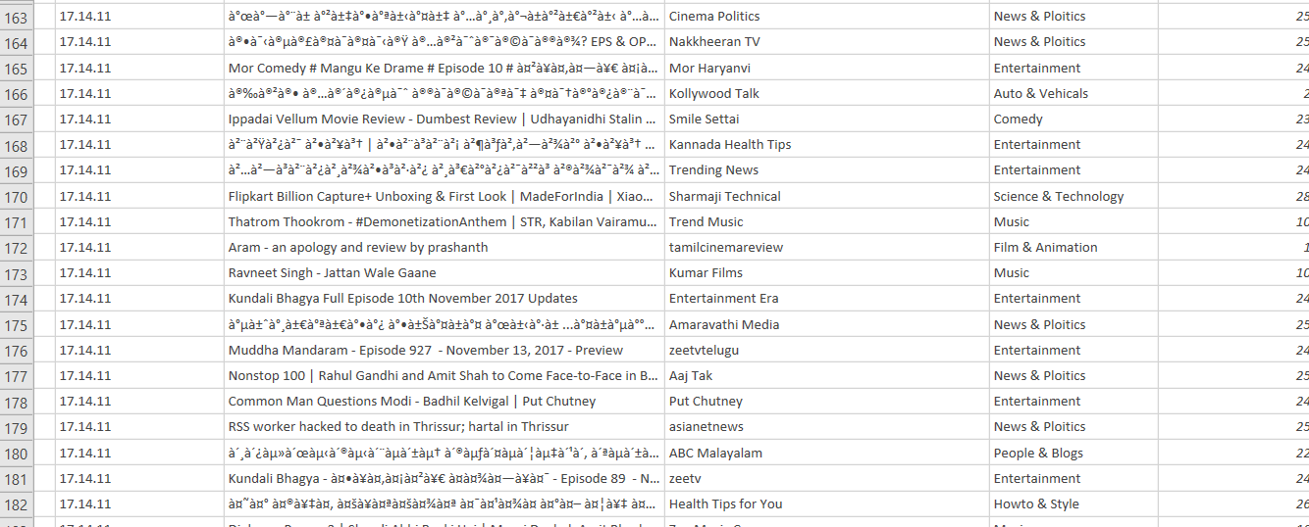
POWER QUERY

Slide 13
DESCRIPTIVE ANALYSIS USING SQL SERVER 2014 MANAGEMENT STUDIO
SQL Server 2014 Management Studio is a relational database management system, or RDBMS, that supports a wide variety of transaction processing, business intelligence and analytics applications in corporate IT environments.
It allows to capture the Business Intelligence based upon Scenarios .

Slide 14
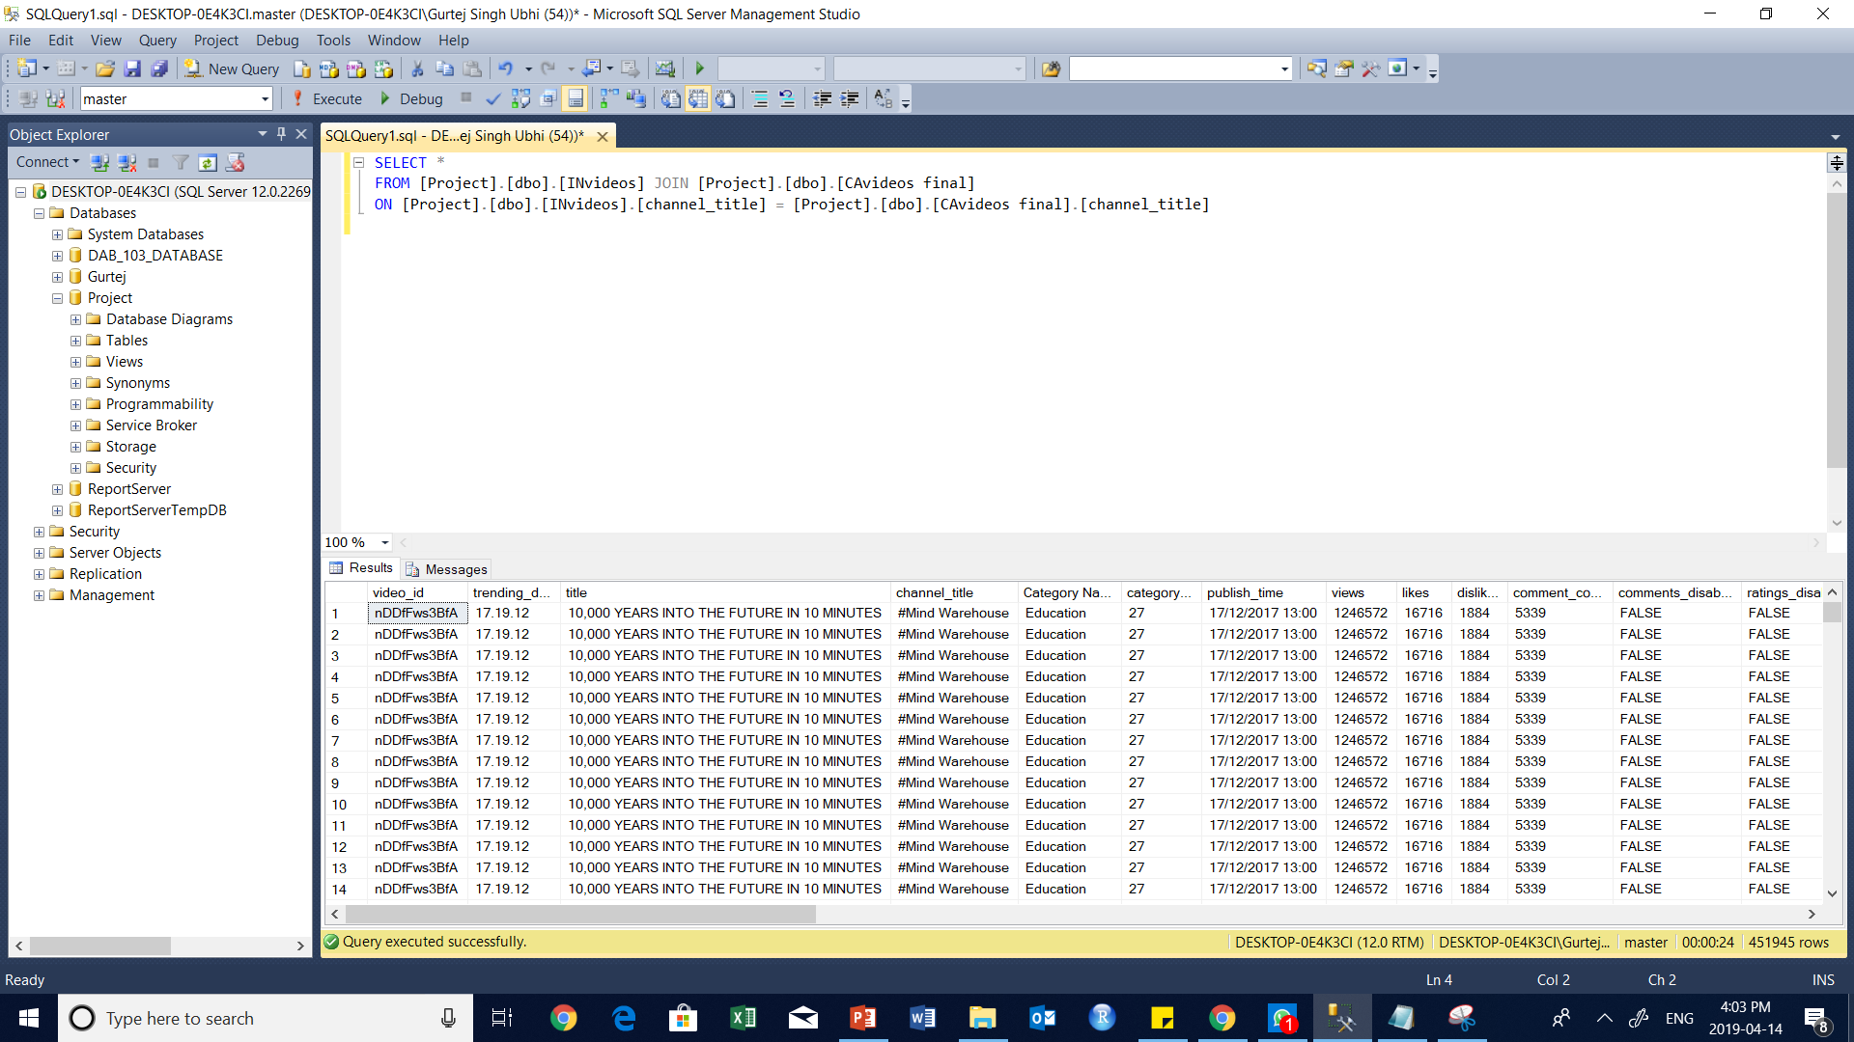

Slide 15
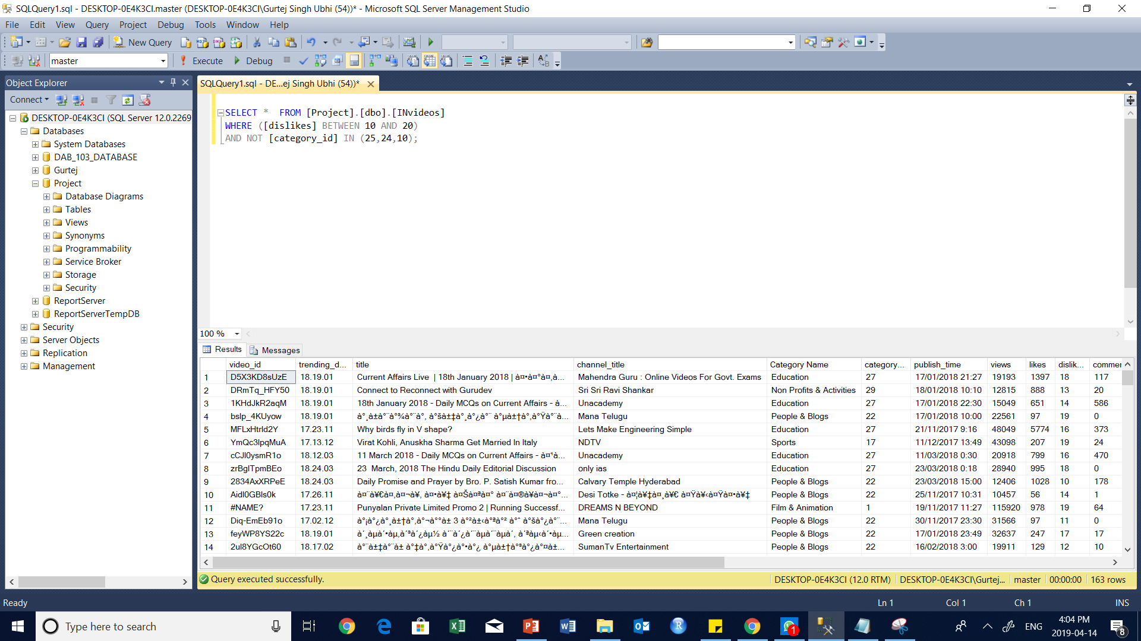

Slide 16
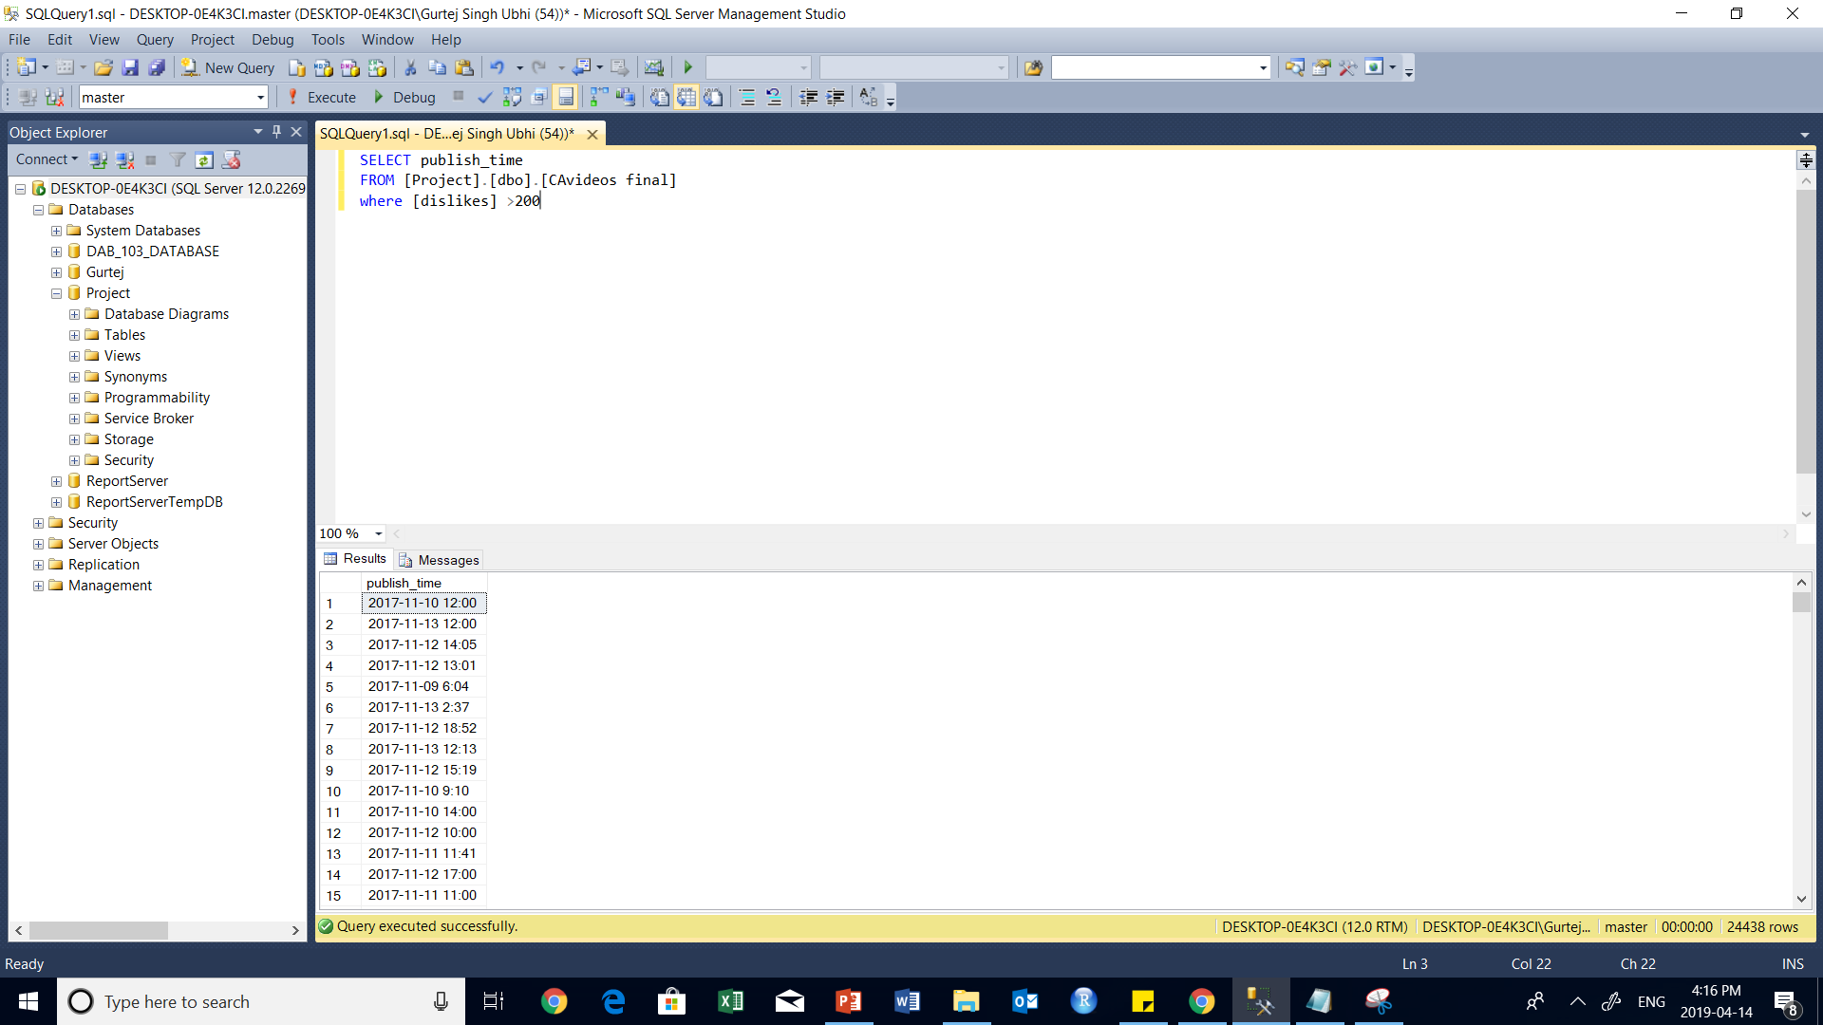

Slide 17


Slide 18
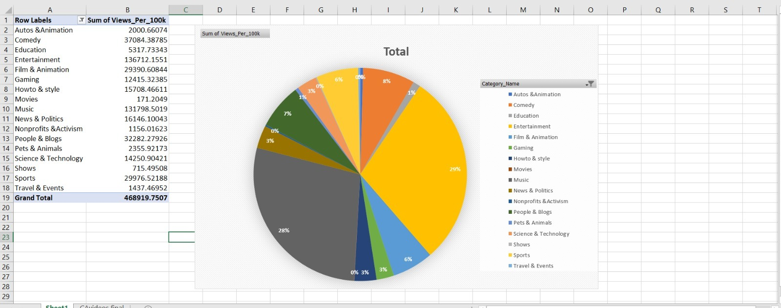
SUM OF TOTAL VIEWS – CANADA

Slide 19
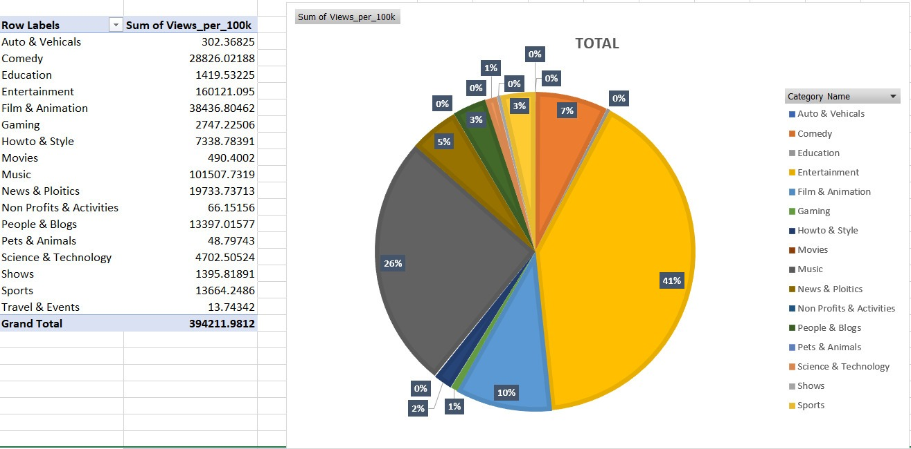
SUM OF VIEWS- INDIA

Slide 20
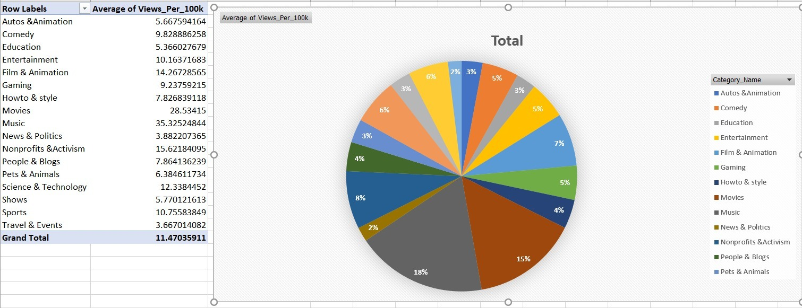

Slide 21
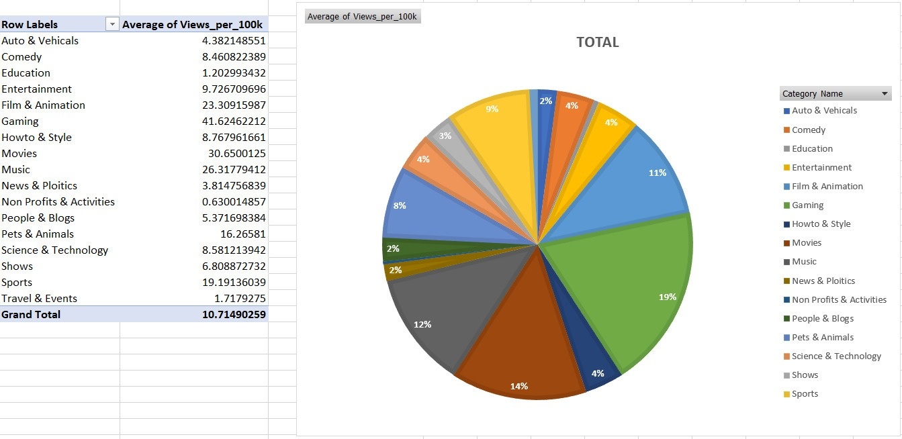

Slide 22
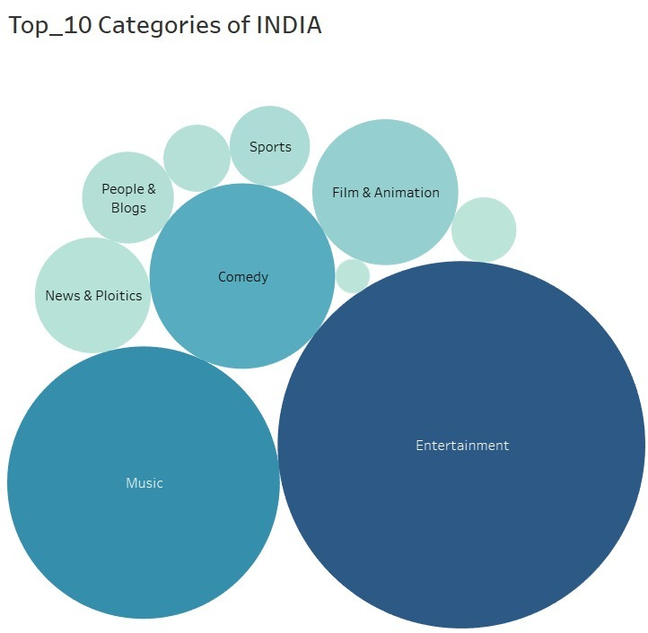
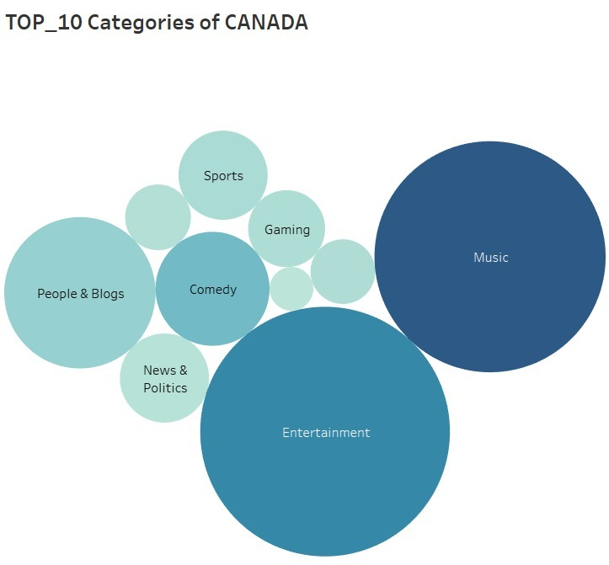
COMPARITIVE ANALYSIS OF TOP_10 CATEGORIES

Slide 23
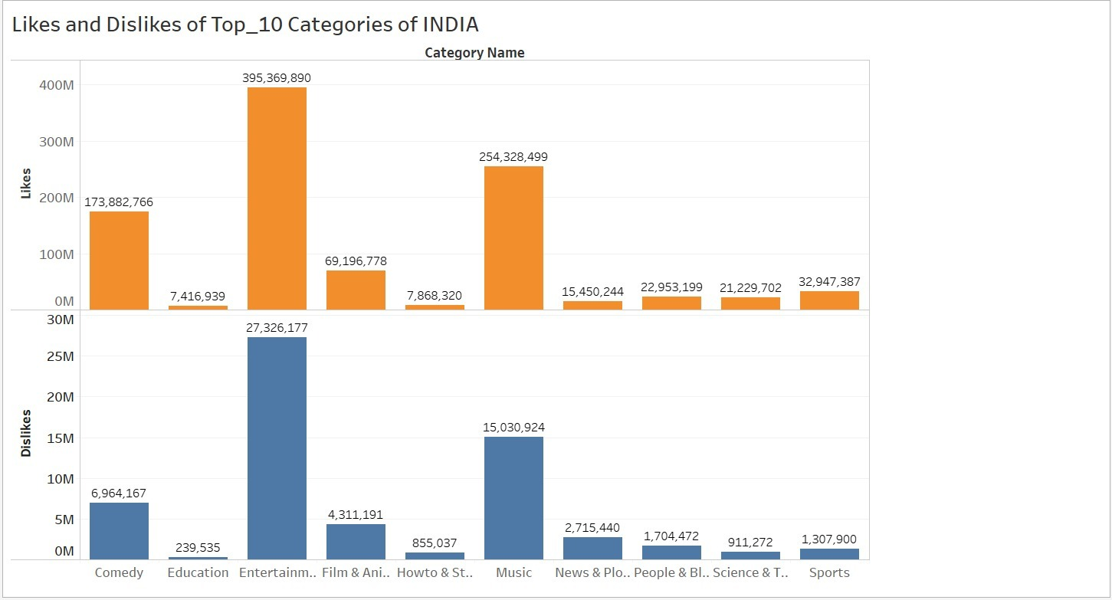
DESCRIPTIVE ANALYSIS OF LIKES AND DISLIKES FOR INDIA

Slide 24
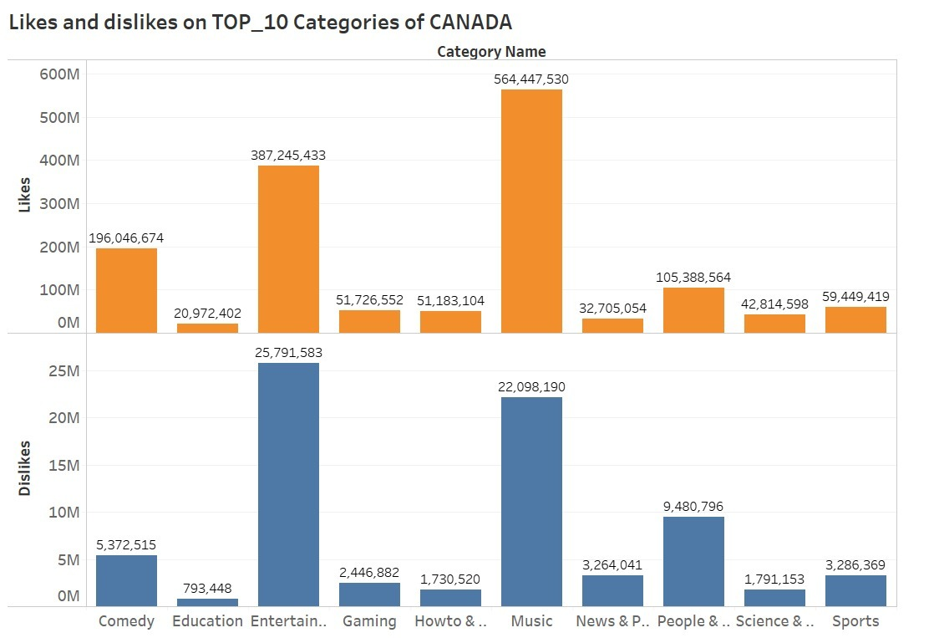
DESCRIPTIVE ANALYSIS OF LIKES AND DISLIKES FOR CANADA

Slide 25
CONCLUSION
Exposure to different categories.

Slide 26
REFERENCES
https://b-i.forbesimg.com/ericenge/files/2014/01/youtube-growth-graph-red.png
https://webuser.hs-furtwangen.de/~heindl/ebte-09ss/Youtube-PPT.ppt
https://seeklogo.net/wp-content/uploads/2016/12/youtube-icon-vector.png

